Slide 1
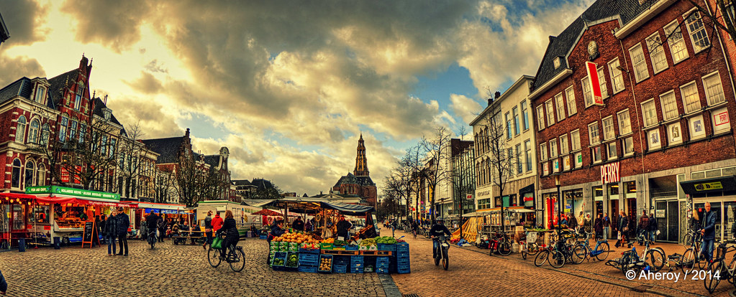
Human Response to disease in European urban geography
a presentation by andres gamez

Slide 2
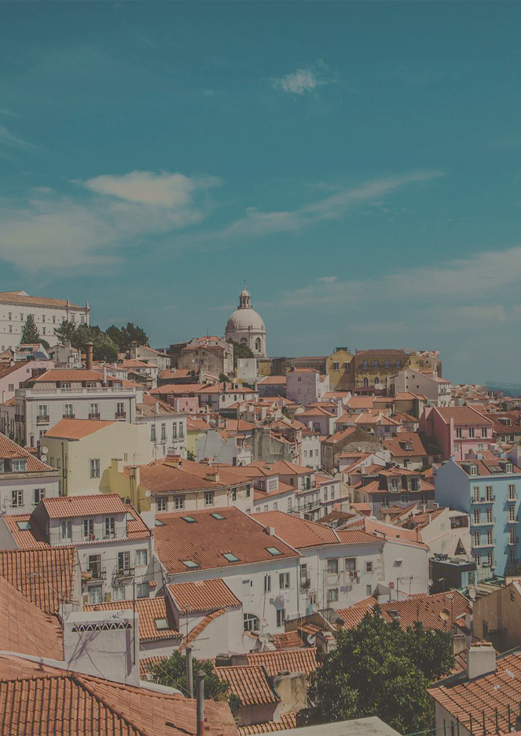
Topics of Discussion
3 | Analysis of Lilley's Points
5 | Analysis of MMP et al.'s points
7 | methods
8 | comparison

Slide 3
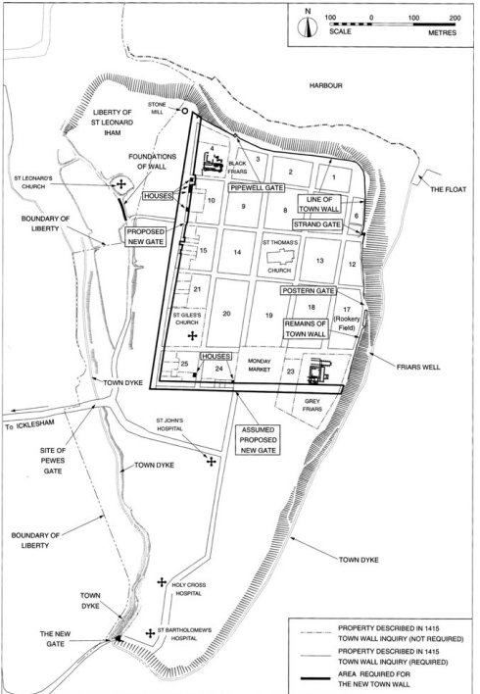
Urban Planning after the Black Death: Townscape Transformation in Later Medieval England (1350–1530) -Keith D. Lillley
Effects of the Black Death in England
Reduced urban populations through death and relocation.
Made some cities infrastructure defunct.
English urban Adaptations
Consolidation of English towns into smaller and improved communities.
The homogeneous culture and government of the English allowed them to act decisively.
Construction of new civic works and improvements to infrastructure.

Slide 4
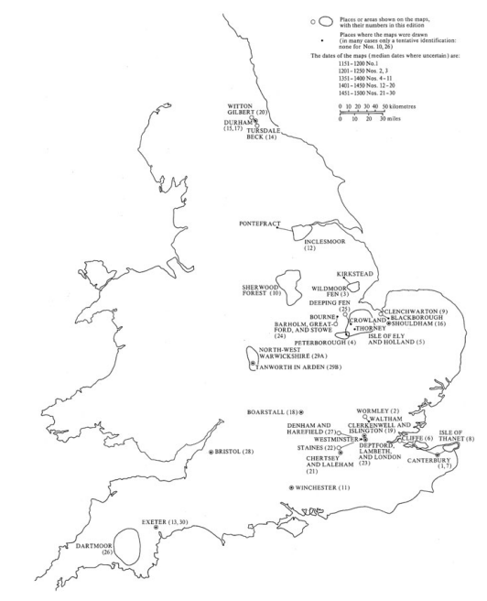
Urban planning after the Black Death
Lilley's Connection to urban design
A society facing 'urban decay' would not support these projects.
Showed that there was optimism for the progression of society.
New towns continued to be established throughout the Medieval period.
Effects of English Adaptations
Developed urban planning as a profession and field of study.
Ensured the survival of English towns through the Medieval period.

Slide 5
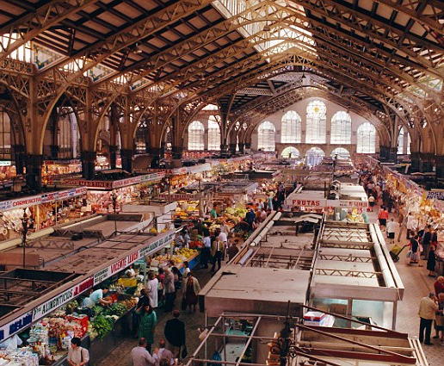
Re-producing public space: the changing everyday production of outdoor retail markets
Covid-19 on Urban markets
MMP et al.
Governments shut down public markets to slow the spread of Covid-19.
Diminished the social space that markets function as for the elderly, immigrants, single parents, and small families.
Affecting traders' livelihoods.
Adaptations to Covid-19
Traders introduced online ordering/ delivery options for their goods.
Re-opening markets with reduced capacity for traders and patrons to preserve some of the 'market spirit'.
Continuing of the social sphere.
"Valencias Central Market … " - DailyMail UK

Slide 6
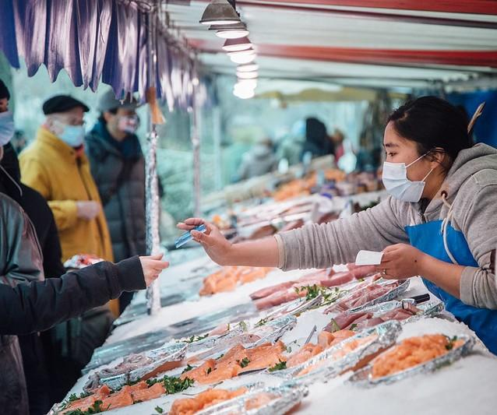
Reproducing Public Space -MMP et al.
MMp et al.'s arguments
Changes to the venue and model of traders allowed the 'market spirit' to endure.
The shift of markets away from public sphere redefined the market spirit in the private sphere.
Effects of adaptation
Some traders adapted to use online order and delivery methods.
Some traders lost their businesses.
Largely, most traders and patrons have gone back to pre-covid market models.
"Fifth Covid-19 Surge … " - CIDRAP News, UMN.

Slide 7
Methods
Ethnographic research: interviews, participant observation,
Newspaper articles
Twitter
MMp et al. methods
English government records: commissions & administrative records.
Personal diaries and correspondence
Recreated maps
Lilley
methods

Slide 8
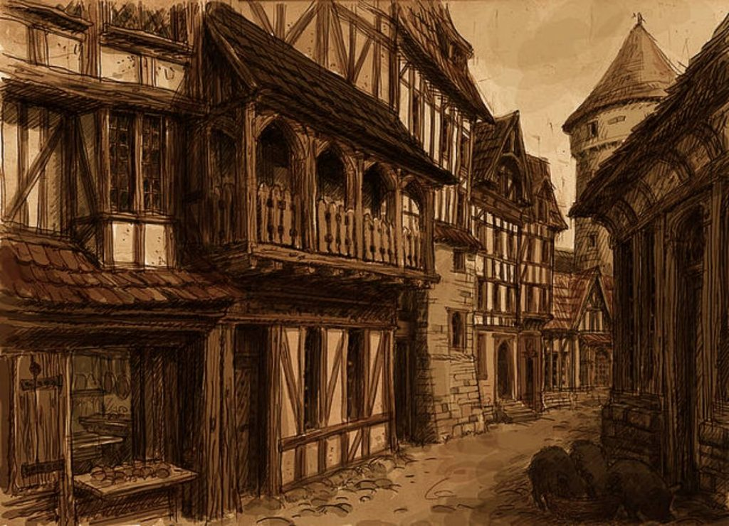
Comparisons
Life in Medieval Towns and Villages - Brewminate
Regions studied
Research
Lilley: England
MMP et al.: Spain, the U.K., Switzerland, & the Netherlands
Both focused on how disease affected urban space in Europe.
2
4
Populations
studied
Paper Organization
Lilley: Medieval English
MMP et al: Modern Europeans
Lilley: Historical & broad analysis
MMP et al.: Research style analysis
1
Differences in Time Period
Lilley: England from 1350-1530
MMP et al.: Europe 2020-2022
3
5

Slide 9
BIBliography
Lilley, Keith D. “Urban Planning after the Black Death: Townscape Transformation in Later Medieval England (1350–1530).” Urban History, vol. 42, no. 1, 2015, pp. 22–42. JSTOR, https://www.jstor.org/stable/26398341, Accessed 7 Mar. 2023.
MMP, Markus Breines, Janine Dahinden, Gunvor Jónsson, Maria Lindmäe, Marco Madella, Joanna Menet, Joris Schapendonk, Emil Van Eck, Rianne Van Melik & Sophie Watson “Re-producing public space: the changing everyday production of outdoor retail markets.” Urban Geography, vol 43, no. 6, 2022, 878-885, DOI: 10.1080/02723638.2022.2054604 Accessed 7 Mar. 2023.
“Life in Medieval Towns and Villages.” Brewminate, April 3, 2023. https://brewminate.com/life-in-medieval-towns-and-villages/. Accessed April 28, 2023
“Fifth Covid-19 Surge Tests European Countries.” CIDRAP. Accessed April 28, 2023. https://www.cidrap.umn.edu/fifth-covid-19-surge-tests-european-countries.
“Valencia's Central Market Stall Owners Set to Charge Tourists Who Don't Buy Anything.” Daily Mail Online. Associated Newspapers, August 7, 2014. https://www.dailymail.co.uk/travel/travel_news/article-2718715/Pay-Spanish-stall-owners-charge-tourists-visit-Valencia-s-central-market-refuse-buy-anything.html. Accessed April 28, 2023

